Slide 1

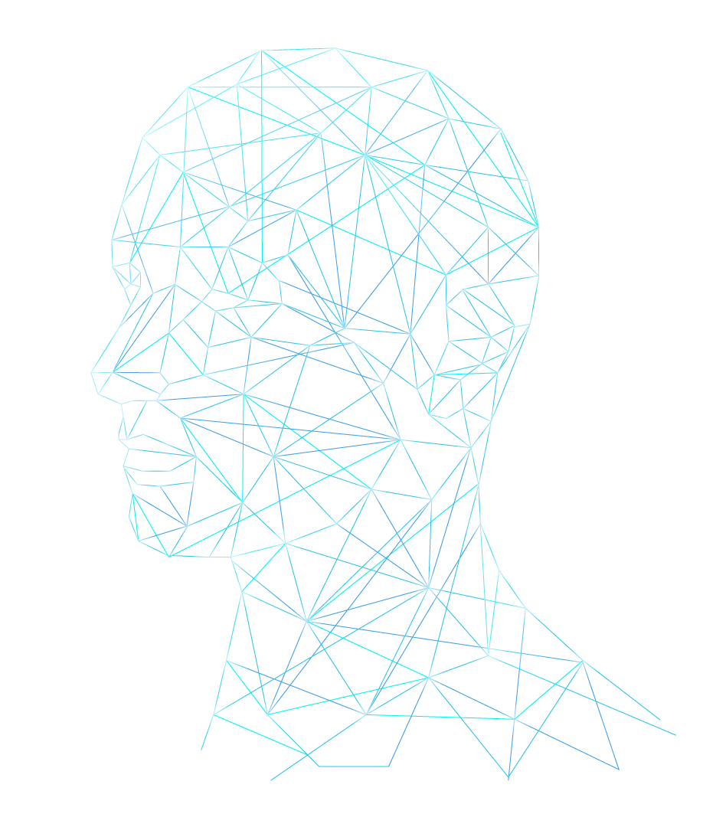
Facial Micro Expressions
Students: Jeneen Jaber
Ayah Abdalmuti

Slide 2

ABOUT Facial Micro-Expressions
What are Facial Micro-Expressions? Micro-expressions (MEs) are facial expressions that occur within a fraction of a second. This uncontrolled emotional leakage exposes a person’s true emotions.
Why Study Micro-Expressions?
Enhanced Security: Detect deception in criminal investigations, airport security and strengthen biometric authentication systems by leveraging micro-expressions' inability to be easily faked.
Improved Emotional Understanding: Aid in identifying psychological conditions and monitoring mental health, such as detecting suppressed emotions.
Enhanced Safety & Well-Being: Driver monitoring systems to detect fatigue or stress for safer driving environments and surveillance in sensitive areas to identify suspicious behavior.

Slide 3
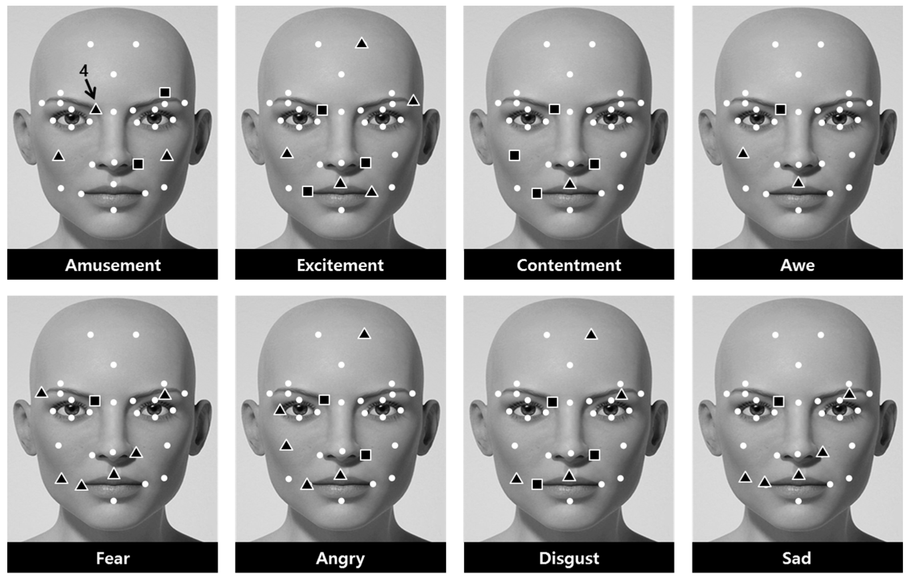

Slide 4
History & Scientific Experiments
Paul Ekman contribution and research: Micro-expressions (MEs) were discovered by Paul Ekman in 1967 during his research on facial expressions and body movements. While studying patients who denied being depressed but later committed suicide, Ekman and Wallace Friesen analyzed slow-motion films and identified micro facial expressions that revealed hidden negative emotions.

Slide 5
Why Facial Micro-Expressions Importance in Security?
1
Attacker Intent Detection: Detecting these subtle signs helps identify potential threats early.
2
Understanding Behavior: This is useful for assessing whether someone is being deceptive or hiding something.
3
Quick Threat Response: Detecting them in real-time allows security personnel to respond quickly to potential threats.
4
Better Security Systems:It can help enhance the ability to detect hidden threats such as attack.

Slide 6
Facial Micro-Expressions Applications In Real World
Human Resources and Recruitment
Security and Deception Detection
Negotiation and Conflict Resolution
Psychology and Therapy
Used in law enforcement and security to detect deception (lie detection).
Helps therapists understand unspoken emotions , aiding in diagnosis of disorders and treatment.
Used in job interviews to detect signs of discomfort or deception.
Assists in identifying underlying emotions during negotiations or conflict resolution.

Slide 7
Micro-Expressions vs. Macro-Expressions
Micro-Expressions
Macro-Expressions
These are brief, subtle facial expressions lasting less than 500 milliseconds that reveal true emotions.
These are longer facial expressions lasting between 0.5 to 4 seconds, easier to notice, and can be faked.

Slide 8
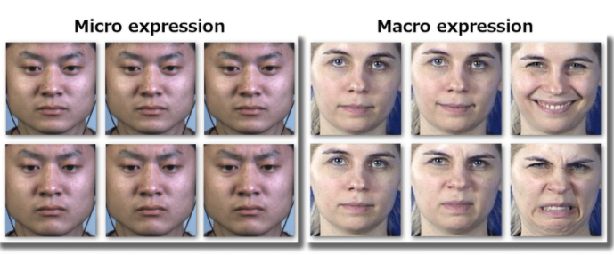

Slide 9
Classification of Micro-Expression Datasets
Micro-expression datasets are classified as acted or spontaneous.
- Acted samples are performed by subjects after instruction,
- While spontaneous samples capture genuine emotions triggered in real time, making them more authentic.
- Examples of acted datasets include the USFHD and Polikovsky’s databases, while spontaneous datasets include SMIC, CASME, and CASME II.
- This study uses CASME II as it is the most recent, publicly available, and widely used for research.

Slide 10
CASME II Dataset
The CASME II database is an improved version of the CASME dataset,
containing 247 micro-expression samples from 26 participants.
Emotional responses were recorded using a high-resolution camera as participants watched
emotional video clips and rated their intensity on a 7-point scale.
The recordings were divided into frames, pre-processed to remove irregular movements, and
selected based on durations under 500 milliseconds. Samples were labeled using the Facial
Action Coding System (FACS) and categorized into five classes—disgust, happiness, surprise,
repression, and others. The CASME II database was pre-processed before release, including
face detection, video frame division, and labeling with action units. It also marks onset, apex,
and offset frames—onset being the first sign of change, apex showing peak intensity, and
offset marking the return to neutral. The database contains 247 samples recorded at 200 fps.

Slide 11
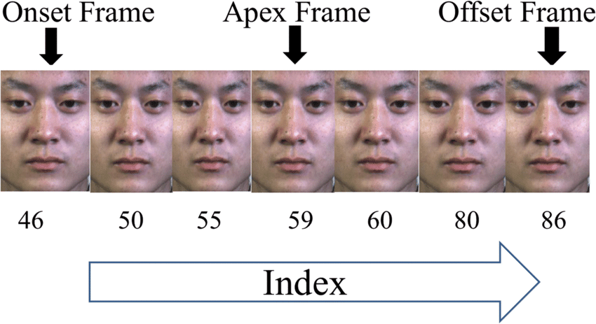

Slide 12
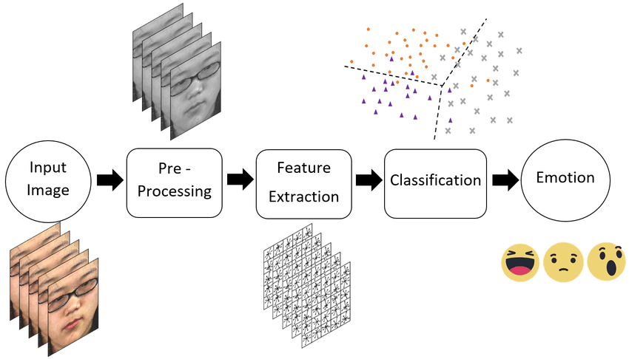

Slide 13
Machine Learning Models Used: Extreme Learning Machine (ELM): Fast learning speed and high accuracy. Support Vector Machine (SVM): Used as a baseline model. Feature Extraction Methods: LBP (Local Binary Pattern) – Apex frames. LBP-TOP (Three Orthogonal Planes) – Spatiotemporal features.
Performance Comparison: ELM vs. SVM (accuracy, precision, recall, F-score). Training time: ELM (0.0409s) vs. SVM (0.3405s). Outcome: ELM performs better in recognizing micro-expressions and is faster.

Slide 14
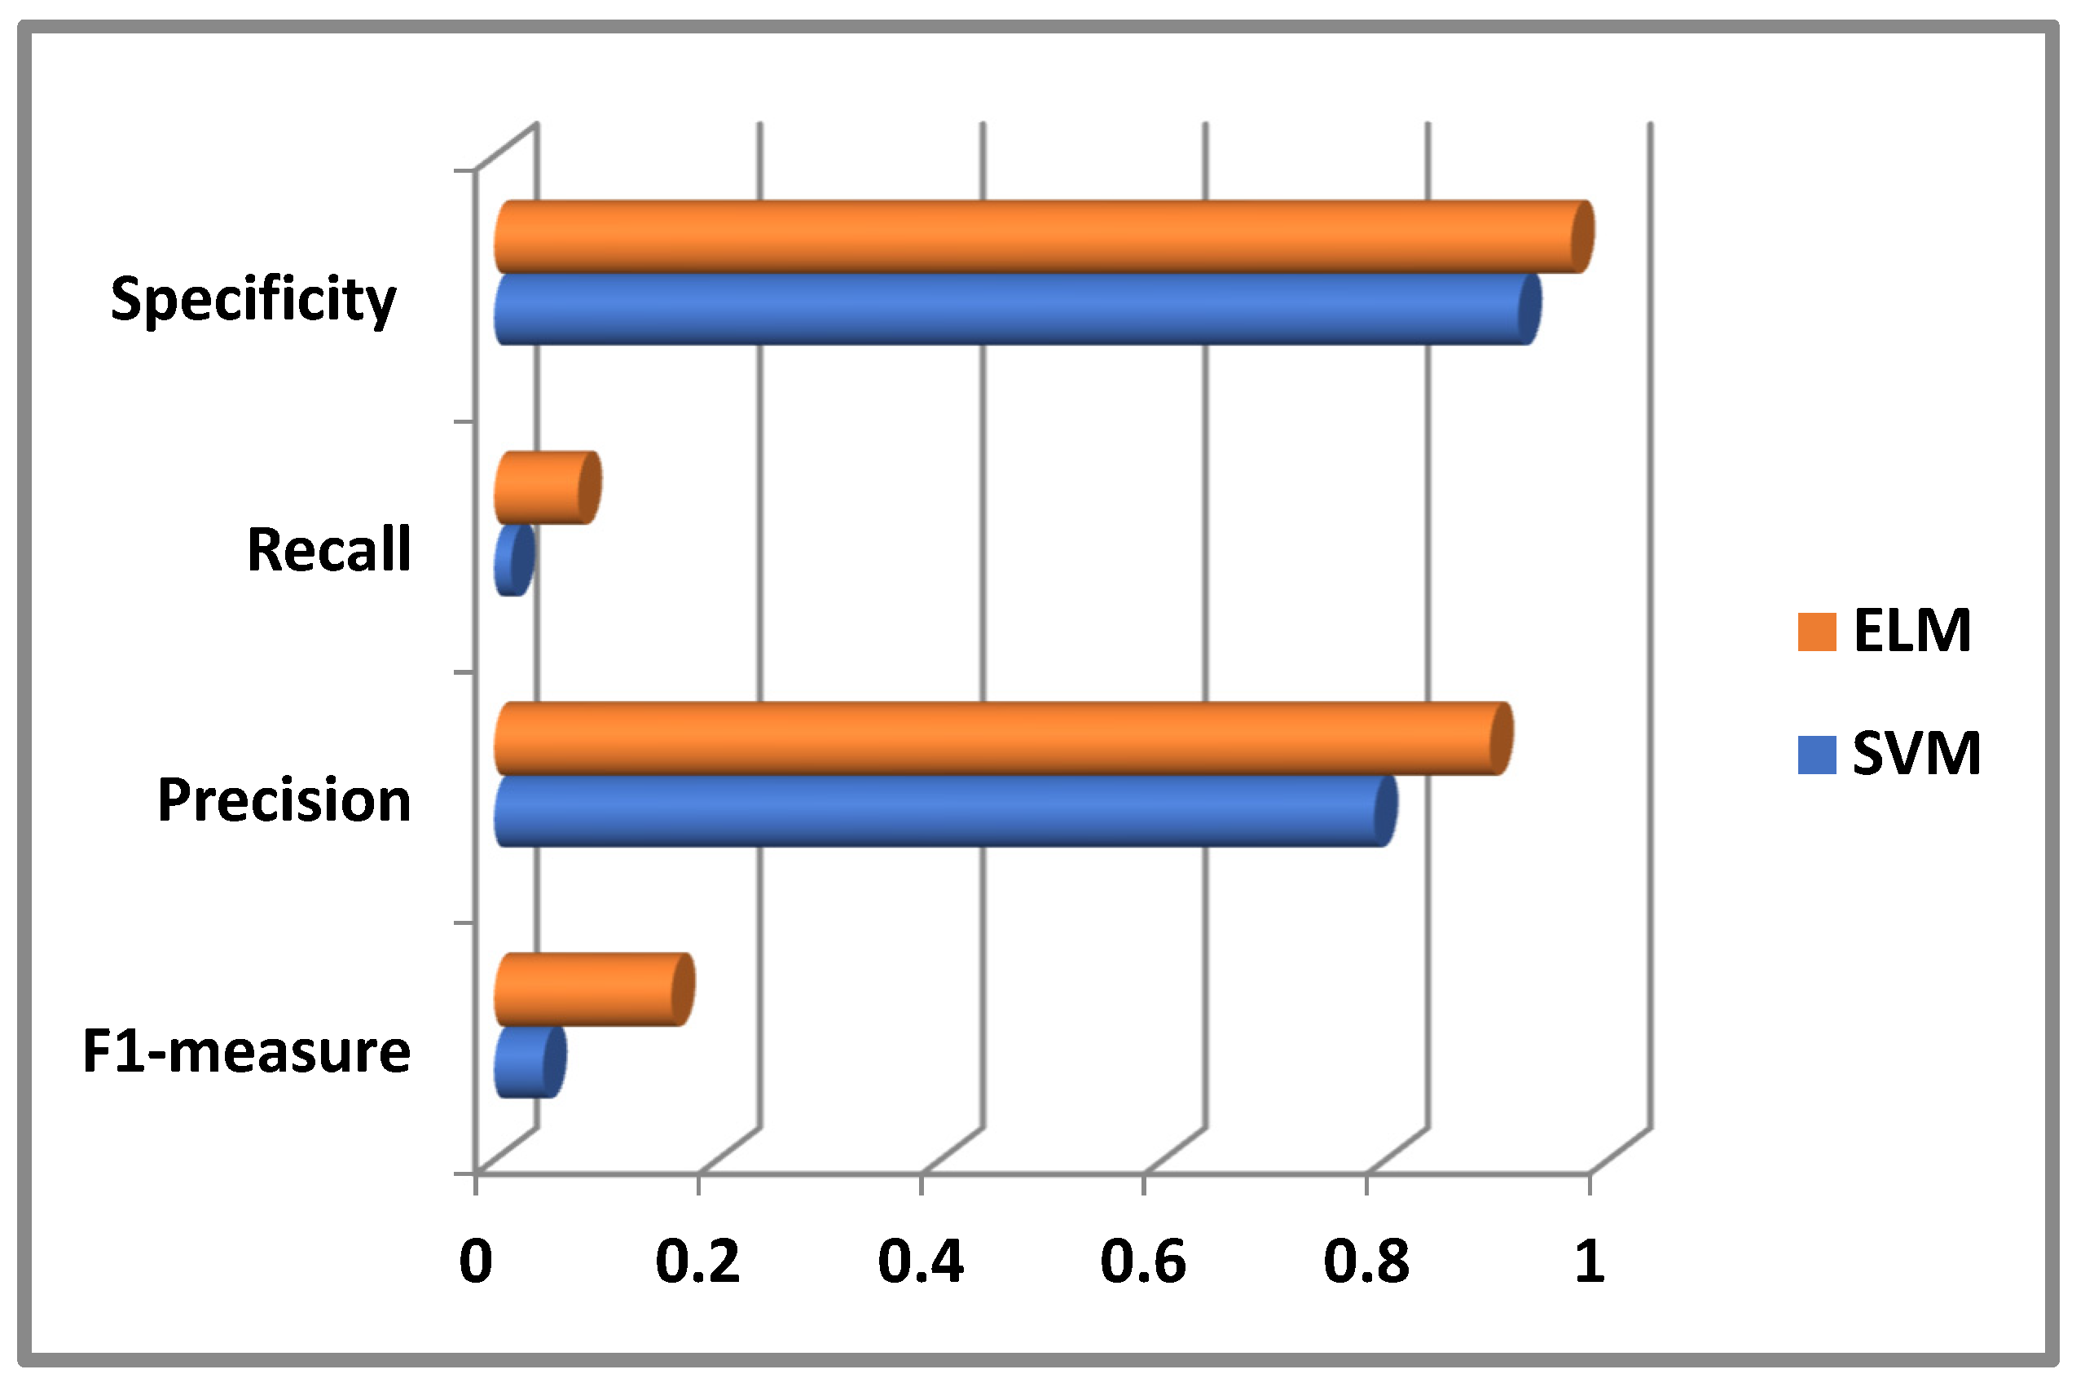

Slide 15
Challenges Of Facial Micro-Expressions
Detection Difficulty
Cultural Differences
People from different cultures may express the same emotions using different facial expressions or interpret certain expressions in various ways.
They are quick and subtle, making them hard to detect and analyze even with advanced technology.
Environmental Factors
External conditions such as poor lighting, incorrect camera angles, or facial obstructions can affect the ability to detect micro-expressions accurately.

Slide 16
Limitations Of Facial Micro-Expressions
Technical Constraints
Data Limitations
Detecting micro-expressions requires accurate algorithms.
There are not enough diverse examples of images or videos showing micro-expressions in different situations
Some of Limitations
Privacy Concerns
Real-Time Analysis
Ethical issues arise from using micro-expression analysis without consent.
Detecting and analyzing subtle facial cues in real-time.

Slide 17
Future Research Directions
Integration with Multimodal System
Adapting to Dynamic Environment
Improving Algorithms
Establishing Ethical Rules
Use micro-expressions along with other information, like voice tone and body movements.
Develop more accurate algorithms for detecting micro-expressions.
Ensure responsible use and protect privacy.
Improve systems to work in crowded places and with moving individuals.

Slide 18
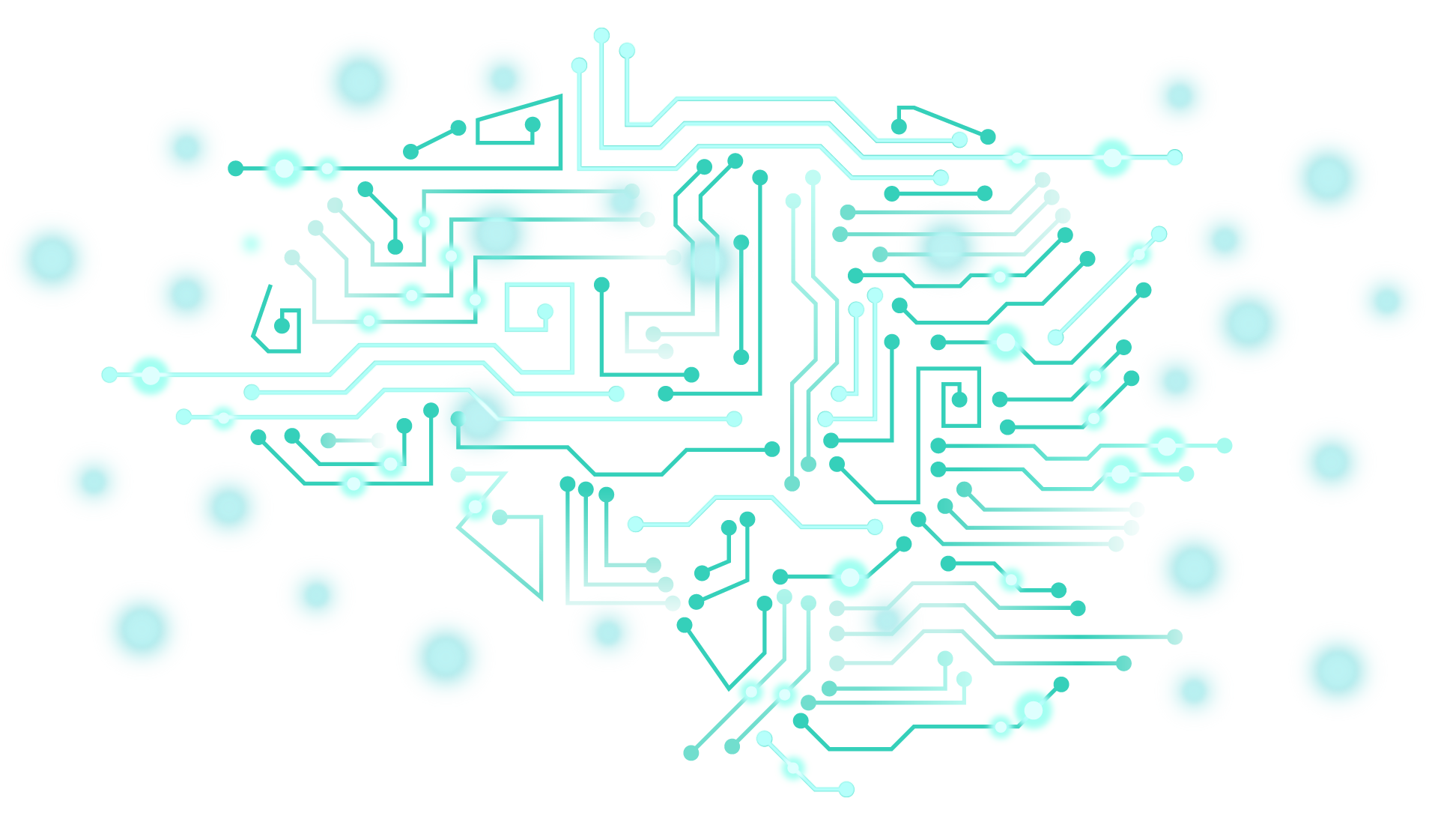
Conclusion
Micro-expressions reveal hidden emotions and have broad applications.
Facial micro-expressions are an advanced technology that could transform identity verification and enhance digital security. Despite challenges in real-world application, they offer significant opportunities to improve authentication methods and protect sensitive information.
As research progresses, micro-expressions could become a crucial part of future biometric systems, paving the way for more accurate and reliable security solutions.

Slide 19
Thank you!

